Slide 1
Perceptron Linear Classifier
Advanced Artificial Intelligence CM4107
Topic 2
Prof Nirmalie Wiratunga

Slide 2
Recap - ML algorithms
In 1959, Arthur Samuel defined machine learning as a
”Field of study that gives computers the ability to learn without being explicitly programmed”.
Machine learning explores the study and construction of algorithms that can learn from and make predictions on data.
Notes:
Machine learning explores the study and construction of algorithms that can learn from and make predictions on data.

Slide 3
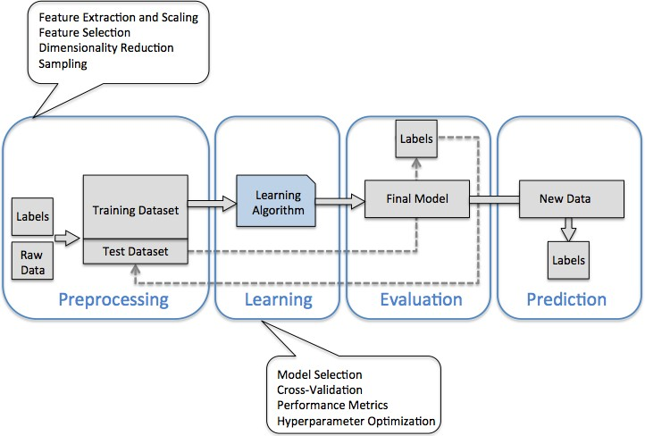
A roadmap for building ML algorithms

Slide 4
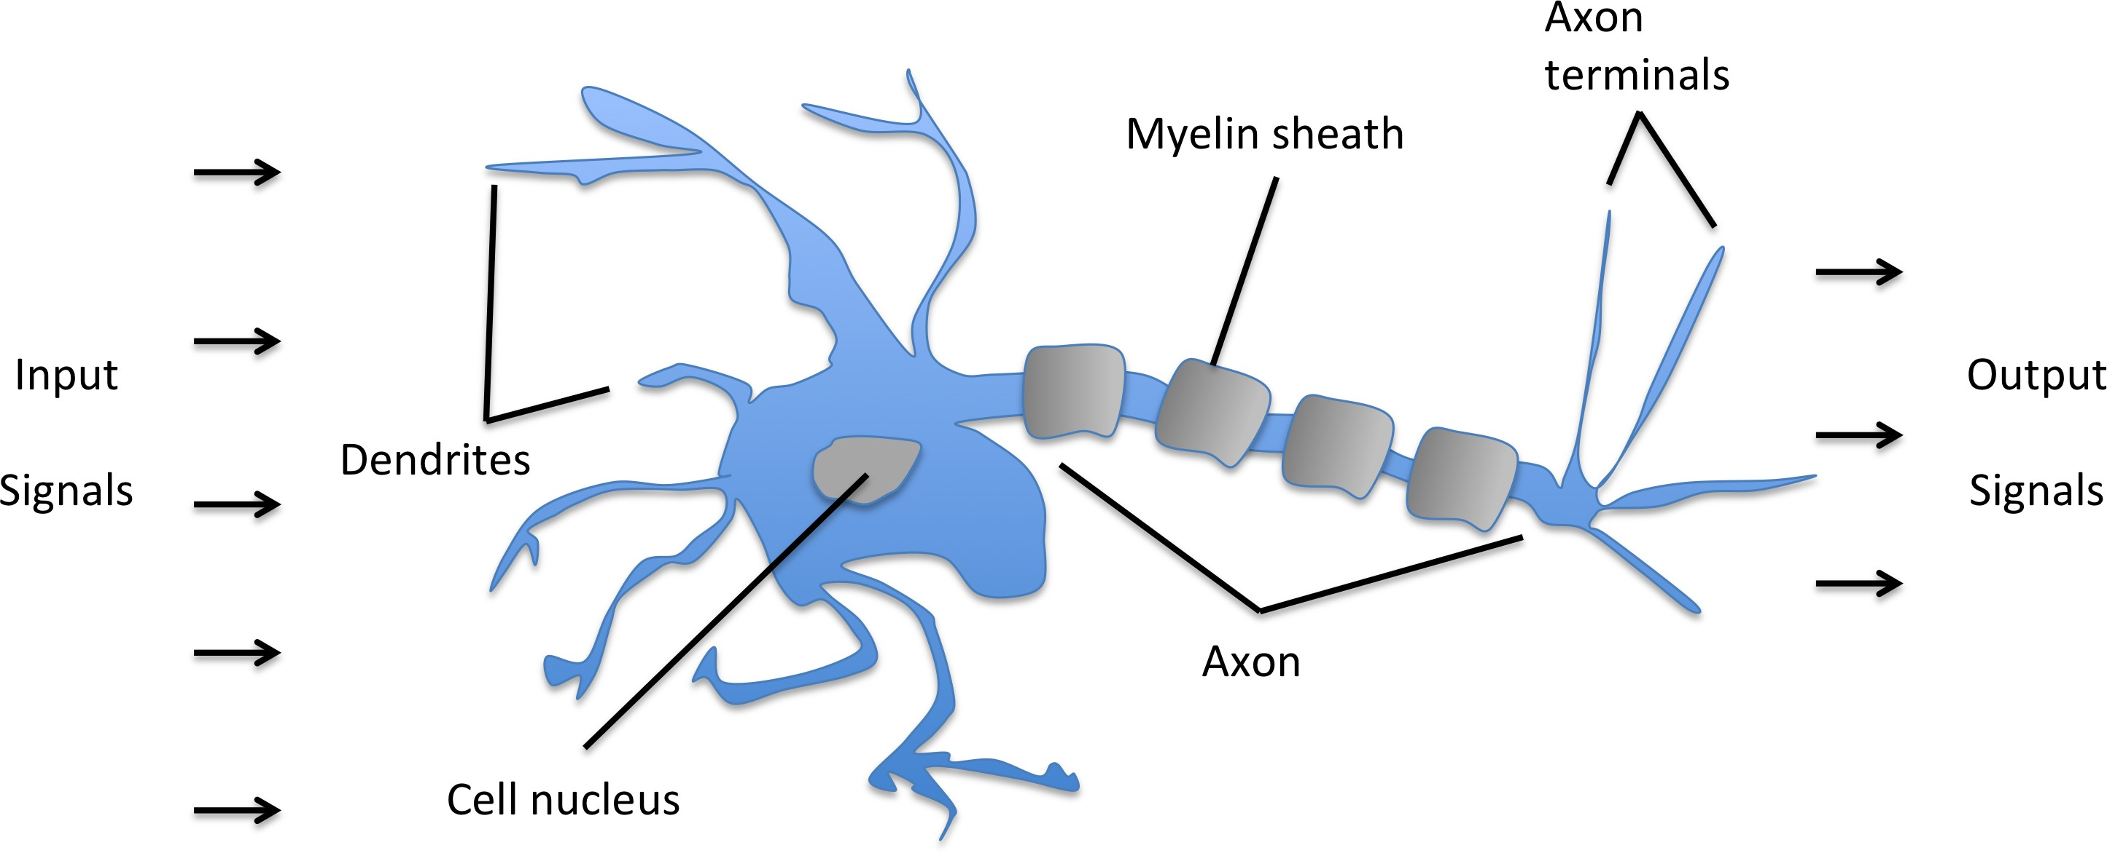
Biology

Slide 5
Logic Gate
Simple logic gate with binary outputs Signals arrive at dendrites
Integrated into cell body
If signal exceeds threshold, generate output, and pass to axon

Slide 6
Maths / Stats Background
Libraries to be used in our labs this week: Numpy and MatplotLib
Notes:
Some background on partial derivatives will be useful to understand the weight update function in neural nets (basic understanding of the power rule and chain rule should be sufficient). Although we will simply implement the derived equations and not really have to prove any of the final equations.
The character ∂ (HTML element: &#8706; or &part;, Unicode: U+2202) or is a stylized d mainly used as a mathematical symbol to denote a partial derivative such as (read as "the partial derivative of z with respect to x").
If we have a function, f = x^3 + y^2 + 1
Then ∂f/∂x is read as “ the partial derivative of f with respect to x” in other words how does f change if we make a small change (delta) to x.
It is useful to have a good understanding of scalars, vectors, matrices and operations (e.g. transpose and dot product).
Probabilities will be useful when we goto naïve bayes lecture.

Slide 7
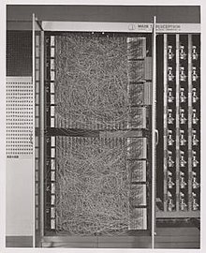
Perceptron one of the 1st ML algorithms
1957 invented by Frank Rosenblantt
The perceptron was intended to be a machine, rather than a program, and while its first implementation was in software for the IBM 704, it was subsequently implemented in custom-built hardware as the "Mark 1 perceptron".
Mark 1 perceptron
Notes:
Machine learning explores the study and construction of algorithms that can learn from and make predictions on data.

Slide 8
Perceptron Learning Algorithm
First neural network learning model in the 1960’s
Simple and limited (single layer models)
Basic concepts are similar for multi-layer models so this is a good learning tool
Basis for understanding artificial neural networks

Slide 9
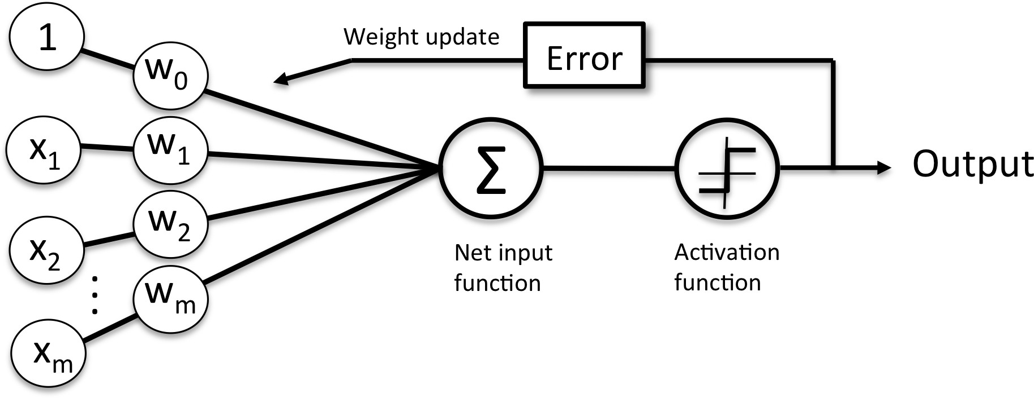
Perceptron Architecture

Slide 10
Rosenblatt Perceptron Learning Algorithm
Binary classification task
Positive class (1) vs. negative class (-1)
Define activation function Ф(z )
Takes as input a dot product of input and weights
Net input: z = w₁x₁ + · · · + w_{m}x_{m}

Slide 11
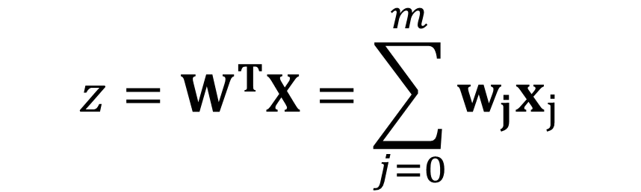
Net Input : Basic Linear Algebra
T is transpose
Vector Dot product
$$z=W^{T}X=\sum_{j=0}^{m}{w_{j}x_{j}}$$
4
5
6
1 2 3 × = 1 × 4 + 2 × 5 + 3 × 6 = 32

Slide 12
Add a Bias feature x₀
z = w₀x₀ + w₁x₁ + · · · + w_{m}x_{m} = w^{T}x
w⁽⁰⁾
x⁽⁰⁾

Slide 13
Activation function : Heaviside Step Function
Check that the dataset class labels match either 1/-1 as representative of binary classification
Ф(z ) known as activation
if activation above some threshold, predict class 1 predict class -1 otherwise
Heaviside Step Function
1 if z ≥ θ
0 otherwise
1 if z ≥ θ
-1 otherwise
Ф(z ) =
Ф(z ) =
Notes:
This greek symbol is PHI

Slide 14
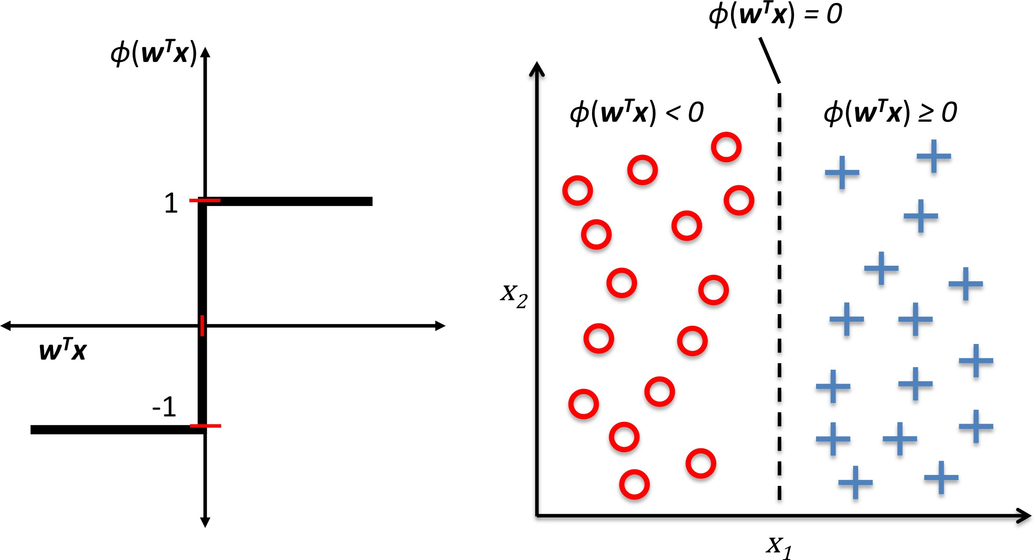
Ф(z) : activation
squashing net input into an output

Slide 15
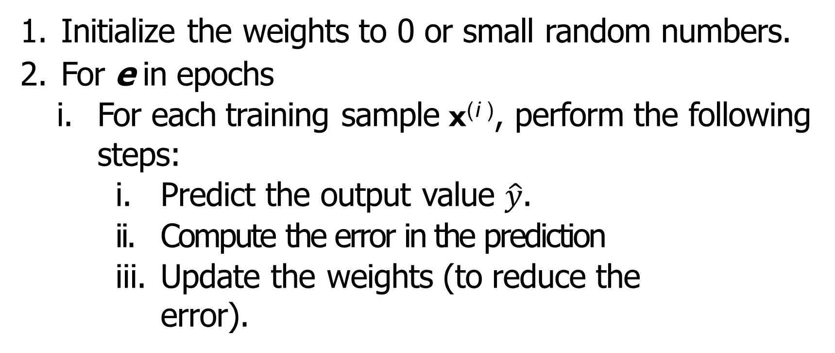
Perceptron Algorithm – learning the model
Initialize the weights to 0 or small random numbers.
For e in epochs
For each training sample x^{(i )}, perform the following steps:
Predict the output value $\hat{y}$.
Compute the error in the prediction
Update the weights (to reduce the error).

Slide 16
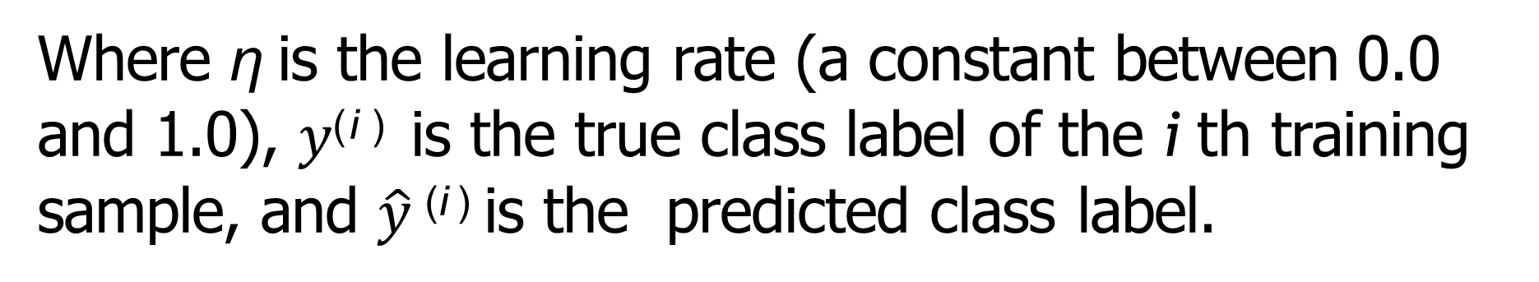
Training the model : Weight Update
Weight update rule:
w_{j} := w_{j} + ∆w_{j}
Perceptron learning rule:
Where η is the learning rate (a constant between 0.0 and 1.0), $y$^{(i )} is the true class label of the i th training sample, and $\hat{y}$^{(i )} is the predicted class label.
Notes:
Here eta is like a moderating factor – it moderates the weight updates to avoid jumping from one update to another. In essence we take a fraction of the of the delta so that the corrections made before are not totally lost and that the current update does not completely dominate learning.
This is important as training examples can sometimes be noisy and we want to ensure that their impact is moderated.

Slide 17
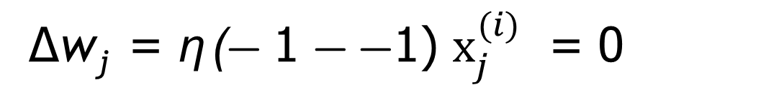
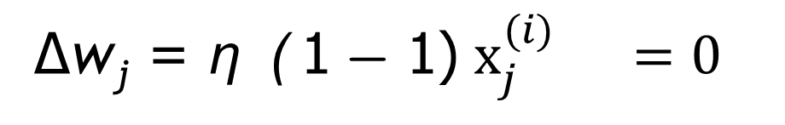
Update Rule Examples
Correct prediction, weights unchanged:
∆w_{j} = η (− 1 − −1) $x_{j}^{(i)}$ = 0
∆w_{j} = η ( 1 − 1) $x_{j}^{(i)} =0$
Since -0.01 <0 the prediction is -1
A CORRECT prediction
So (-1 - -1 ) = 0
Consider a Training instance
0 1 => -1
input
weights
1 0 1
X
-0.05
0.02
0.04
= -0.01
Notes:
η greek symbol used for learning rate

Slide 18
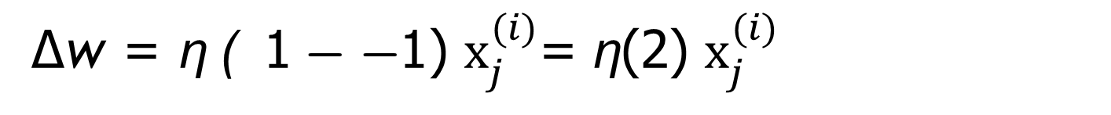
Update Rule Examples
Wrong prediction, weights pushed towards the positive or negative class:
∆w = η ( 1 − −1) $x_{j}^{(i)}$= η(2) $x_{j}^{(i)}$
∆w = η (− 1 − 1 ) $x_{j}^{(i)}$ = η(−2) $x_{j}^{(i)}$
Since 0.02 >=0 the prediction is 1
INCORRECT prediction
So (-1 - 1 ) = -2
Consider a Training instance
0 1 => -1
input
weights
1 0 1
X
-0.02
0.02
0.04
= 0.02
Notes:
η greek symbol used for learning rate

Slide 19

Perceptron Architecture
bias
if z ≥ 0
otherwise
Ф(z)
output a
value+1 or -1
$$W^{T}X$$

Slide 20
Perceptron class in Python
class perceptron(object):
def __init__(self, input_size, lr=0.01, epochs=50, random_state=1):
def net_input(self, x):
def activation(self, x):
def predict (self, x):
def train(self, X, t):

Slide 21
Convergence
Convergence guaranteed if
The two classess linearly separable Learning rate is sufficiently small
If classes cannot be seprated:
Set a maximum number of passes over the training dataset (epochs)
Set a threshold for the number of tolerated misclassifications
Otherwise, it will never stop updating weights (converge)

Slide 22
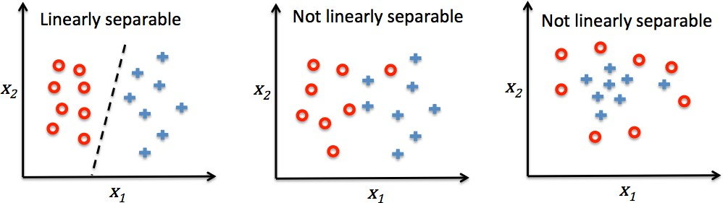
Linear Separability
If no bias then the hyperplane must go through the origin

Slide 23
Augmented Pattern Vectors with Bias input
Input (x) -> class (y)
1 0 1 -> -1
1 0 0 -> 1
Augmented Version with Bias
1 0 1 1 -> -1
1 0 0 1 -> 1
We call it a bias since it biases the output up or down.
Note the input for the bias component is ‘1’
The bias weight, w₀, is learnt like all any other weights
Notes:
Author uses -1 into bias, any real difference (back to being a threshold weight), but since starts random anyway, will make no difference, though the final weight will be negated by comparison

Slide 24
ADAptive LInear NEruon (Adaline)
Weights updated based on a linear activation function
Remember that perceptron used a unit step function Ф(z )
This is simply the identity function of the net input
Ф(w ^{T} x) = w ^{T} x
A quantizer is then used to predict class label

Slide 25
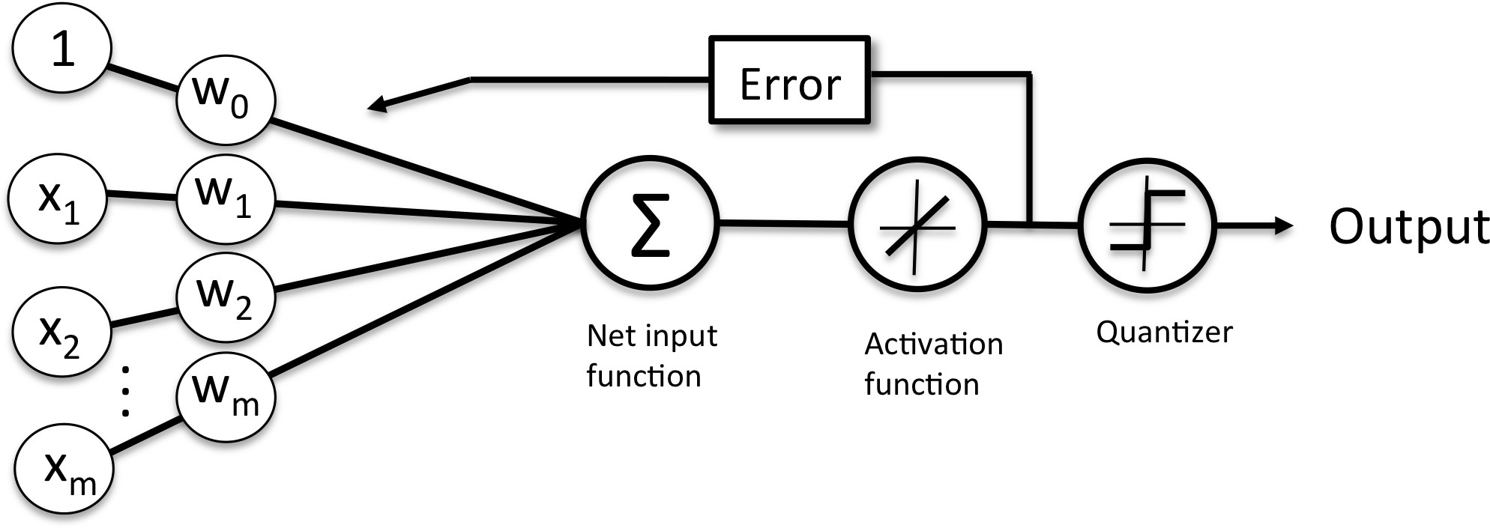
Adaline : Whats the difference with the Perceptron?

Slide 26
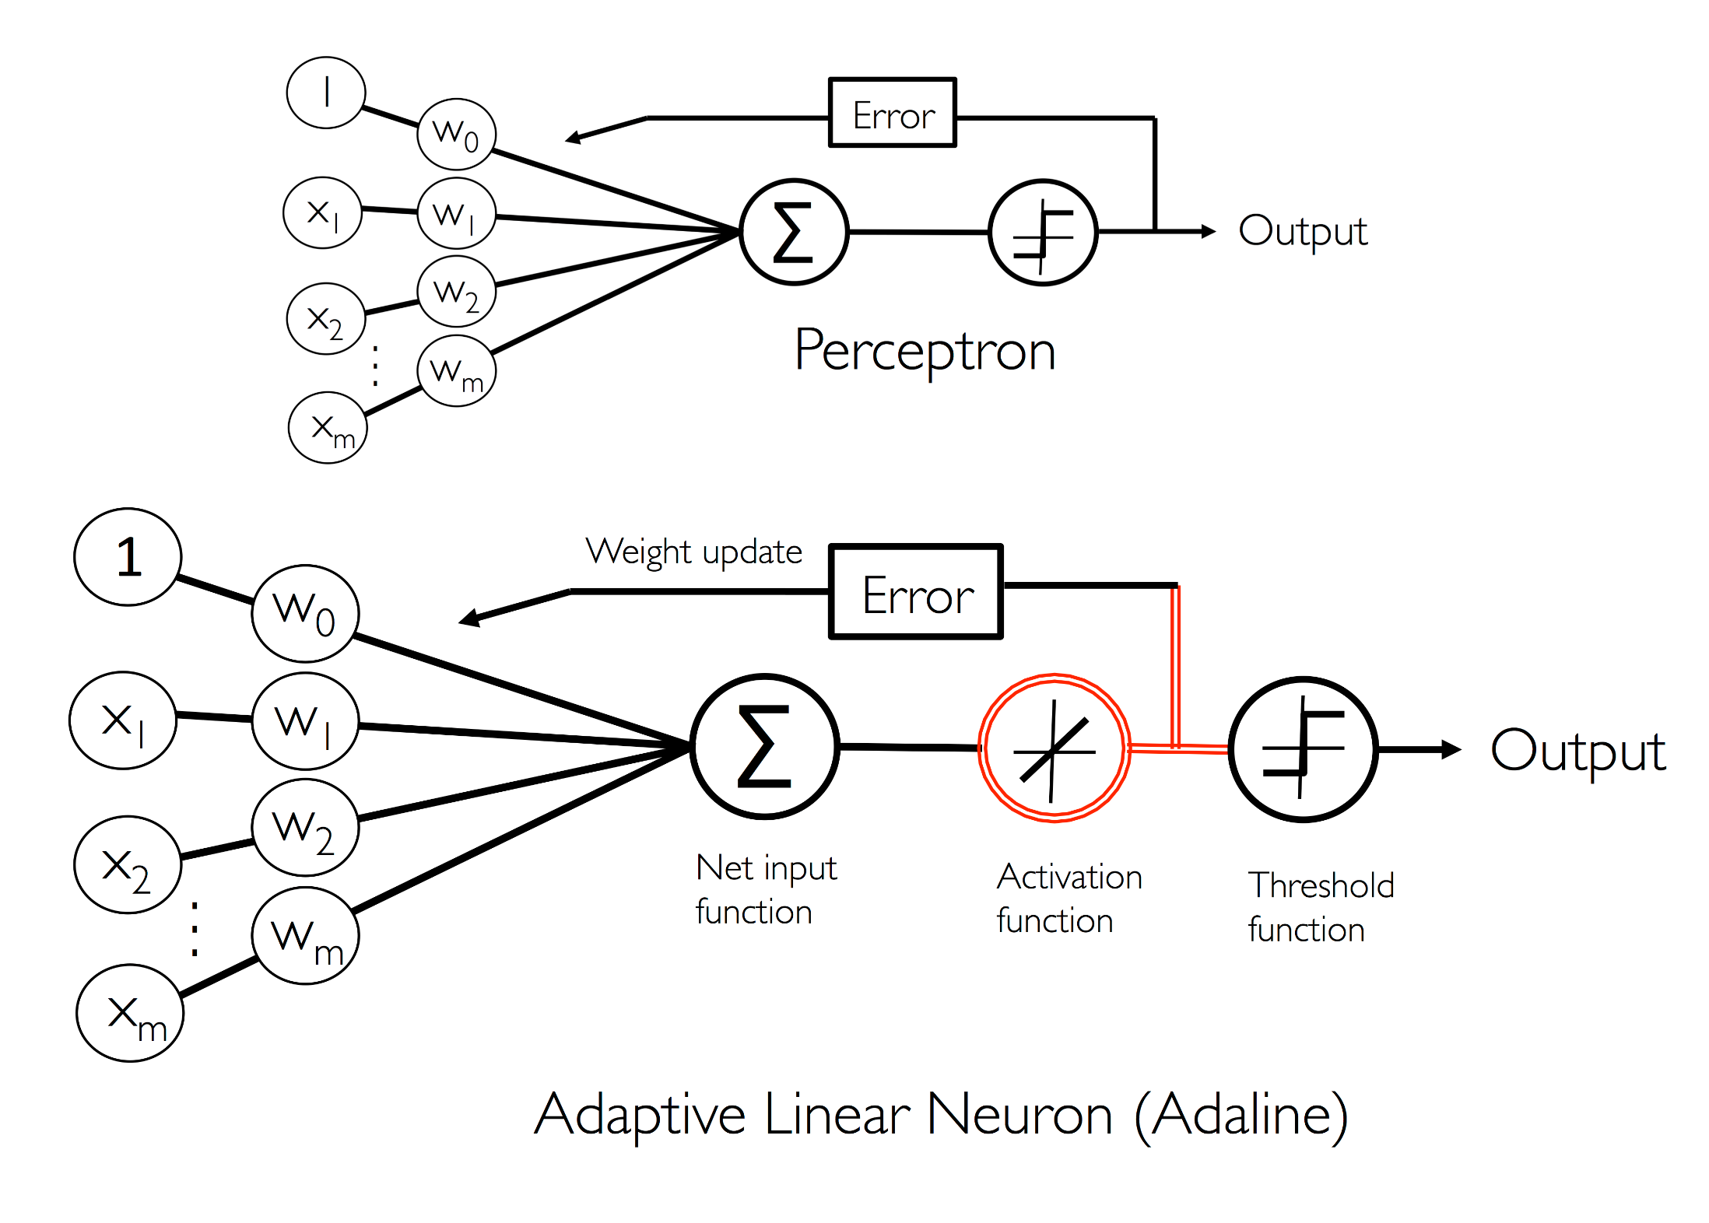

Slide 27
Cost Functions
ML algorithms often define an objective function
This function is optimized during learning
It is often a cost function we want to minimize
Adaline uses a cost function J(·)
Learns weights as the sum of squared errors (SSE)

Slide 28
Advantages of the Adaline cost function
The linear activation function is differentiable
Unlike the unit step function (in the perceptron)
It is convex
Can use gradient descent to learn the weights
Notes:
A convex function is a continuous function whose value at the midpoint of every interval in its domain does not exceed the arithmetic mean of its values at the ends of the interval.

Slide 29
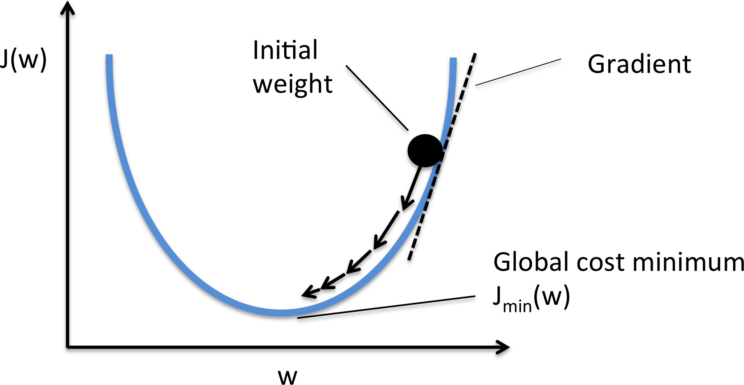
Gradient Descent
gradient points in the direction of the greatest rate of increase of the function, and its magnitude is the slope of the graph in that direction.
Notes:
The questions we need to ask here is how does the error J change as the weight changes.
The slope is marked on the graph and in this case it is a positive gradient.
We want to follow the downward direction so we move towards the left
This means we decrease w a little.
So we modify w oppsite to the direction of the gradient i.e. decrease w when positive gradient and increase w when negative gradient.
Make sure to stop and avoid overshooting the minima
As we get closer to the minima the slope gets shallower.

Slide 30

Gradient Descent - Intuition
https://www.analyticsvidhya.com/blog/2017/03/introduction-to-gradient-descent-algorithm-along-its-variants/
Notes:
Suppose you are at the top of a mountain, and you have to reach a lake which is at the lowest point of the mountain (a.k.a valley). A twist is that you are blindfolded and you have zero visibility to see where you are headed. So, what approach will you take to reach the lake?
The best way is to check the ground near you and observe where the land tends to descend. This will give an idea in what direction you should take your first step. If you follow the descending path, it is very likely you would reach the lake.
Gradient refers to the slope of the ground. You step in the direction where the slope is steepest downwards.

Slide 31
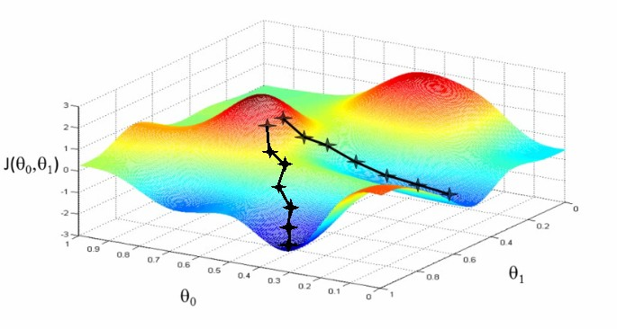
Gradient Descent - Intuition
https://www.analyticsvidhya.com/blog/2017/03/introduction-to-gradient-descent-algorithm-along-its-variants/
Notes:
J is the error
We want to find theta values that minimise the error
We can also get stuck in a local minima that is not the global minima
So training several times with different starts is typical

Slide 32
Gradient Descent
Weights updated by taking small steps Step size determined by learning rate
Take a step away from the gradient ∇J(w) of the cost
function
w := w + ∆w. The weight change is defined as follows:
∆w = −η∇J(w)

Slide 33
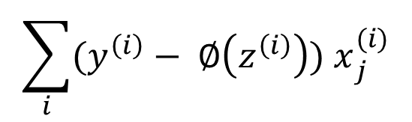
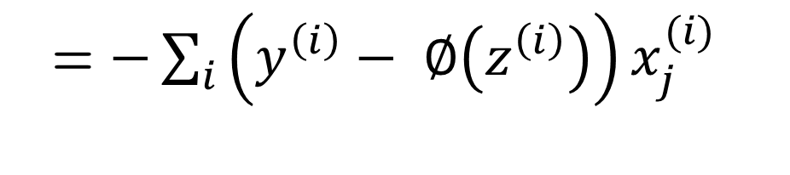
Gradient Computation
To compute the gradient of the cost function, we need to compute the partial derivative of the cost function with respect to each weight w_{j} ,
∂J
∂w_{j}
= $−\sum_{i}{\left(y^{\left(i\right)}− ∅\left(z^{\left(i\right)}\right)\right)x_{j}^{(i)}}$
Weight update of weight w_{j}
∂J
$$\sum_{i}{(y^{\left(i\right)}− ∅\left(z^{\left(i\right)}\right){) x}_{j}^{(i)}}$$
∆w = −η = η
j
∂w_{j}
We update all weights simultaneously, so Adaline learning rule becomes
w := w + ∆w.

Slide 34
Solving the derivatives
Notes:
In case you are interested ; these are the steps of solving the partial deravative of the cost function , J, wrt to the weights, w_i

Slide 35
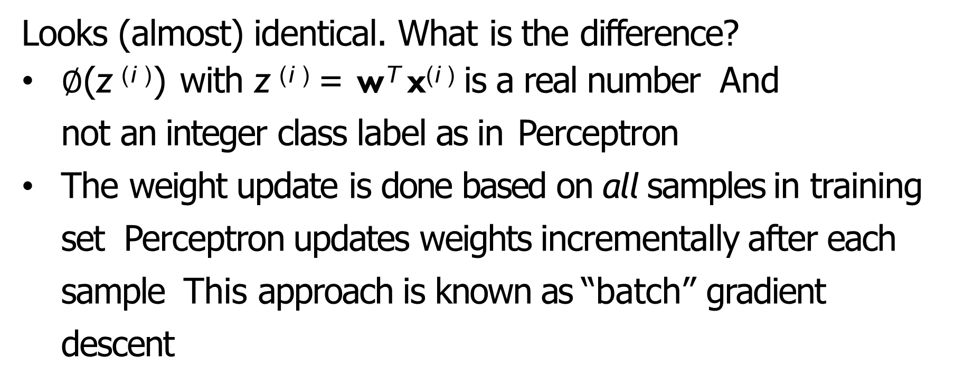
Adaline learning rule vs. Perceptron rule
Looks (almost) identical. What is the difference?
$∅$(z ^{(i )}) with z ^{(i )} = w^{T} x^{(i )} is a real number And not an integer class label as in Perceptron
The weight update is done based on all samples in training set Perceptron updates weights incrementally after each sample This approach is known as “batch” gradient descent

Slide 36
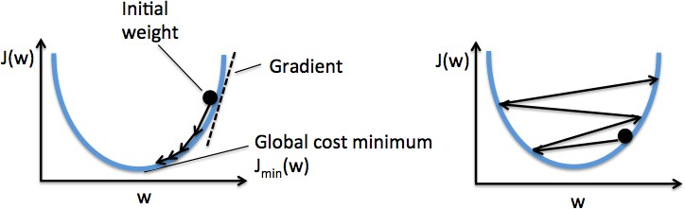
Lessons learned
Learning rate too high: error becomes larger (overshoots global min)
Learning rate too low: takes many epochs to converge Feature normalization

Slide 37
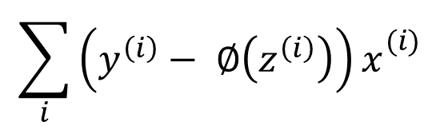
Stochastic gradient descent (SGD)
Large dataset with millions of data points (“big data”) Batch gradient descent costly
Need to compute the error for the entire dataset ...
... to take one step towards the global minimum!
$$\sum_{i}{\left(y^{\left(i\right)}− ∅\left(z^{\left(i\right)}\right)\right)x_{}^{(i)}}$$
∆w = η
SGD updates the weights incrementally for each training sample

Slide 38
SGD details
Approximation of gradient descent
Reaches convergence faster because of frequent weight updates
Important to present data in random order
Learning rate often gradually decreased (adaptive learning rate)
Can be used for online learning
Middle ground between SGD and batch GD is known as
mini-batch learning
E.g. 50 examples at a time
Can use vector/matrix operations rather than loops as in SGD Vectorized operations highly efficient

Slide 39
Conclusion
Perceptron is a binary classifier
It is a linear classifier
Activation is a step function
Fundamental unit of neural nets

Slide 40
Linear Separability

Slide 41
Linear Separability and Generalization
When is data noise vs. a legitimate exception

Slide 42
Limited Functionality of Hyperplane

Slide 43
How to Handle Multi-Class Output
This is an issue with any learning model which only supports binary classification (perceptron, SVM, etc.)
Create 1 perceptron for each output class, where the training set considers all other classes to be negative examples
Run all perceptrons on novel data and set the output to the class of the perceptron which outputs high
If there is a tie, choose the perceptron with the highest net value
Create 1 perceptron for each pair of output classes, where the training set only contains examples from the 2 classes
Run all perceptrons on novel data and set the output to be the class with the most wins (votes) from the perceptrons
In case of a tie, use the net values to decide
Number of models grows by the square of the output classes
Notes:
Use next slide as example

Slide 44
What is the Bias?
w₁x₁ + w₂x₂ >= 0 (Z = 1)
w₁x₁ + w₂x₂ < 0 (Z = -1)
So, What is a decision boundary?
w₁x₁ + w₂x₂ = z
w₁x₁ /w₂+ x₂ = z/w₂
x₂ = (- w₁w₂ )/x₁+ z/w₂
y = MX+ B
Div by w₂
Solve for x₂
If no bias then the hyperplane must go through the origin
Notes:
What if no bias?

